Slide 1
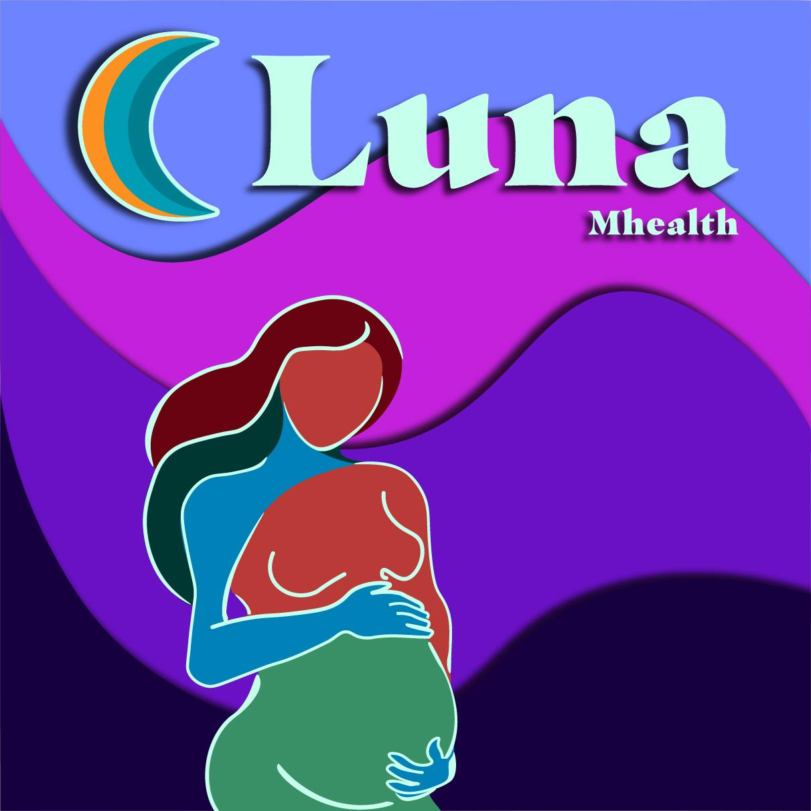
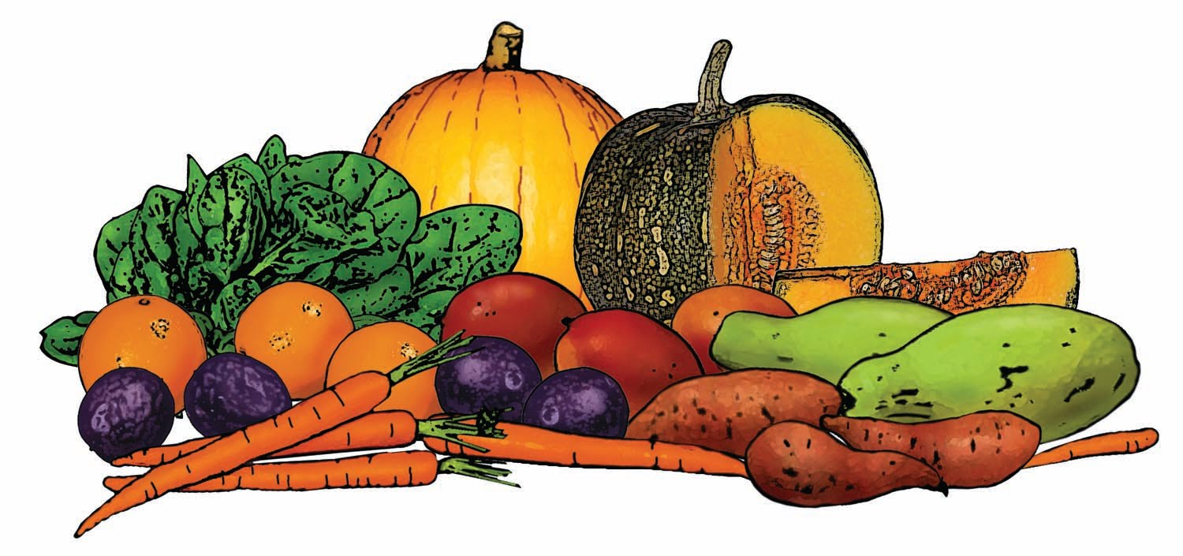


Nutrition
Gestational Diabetes

Slide 2
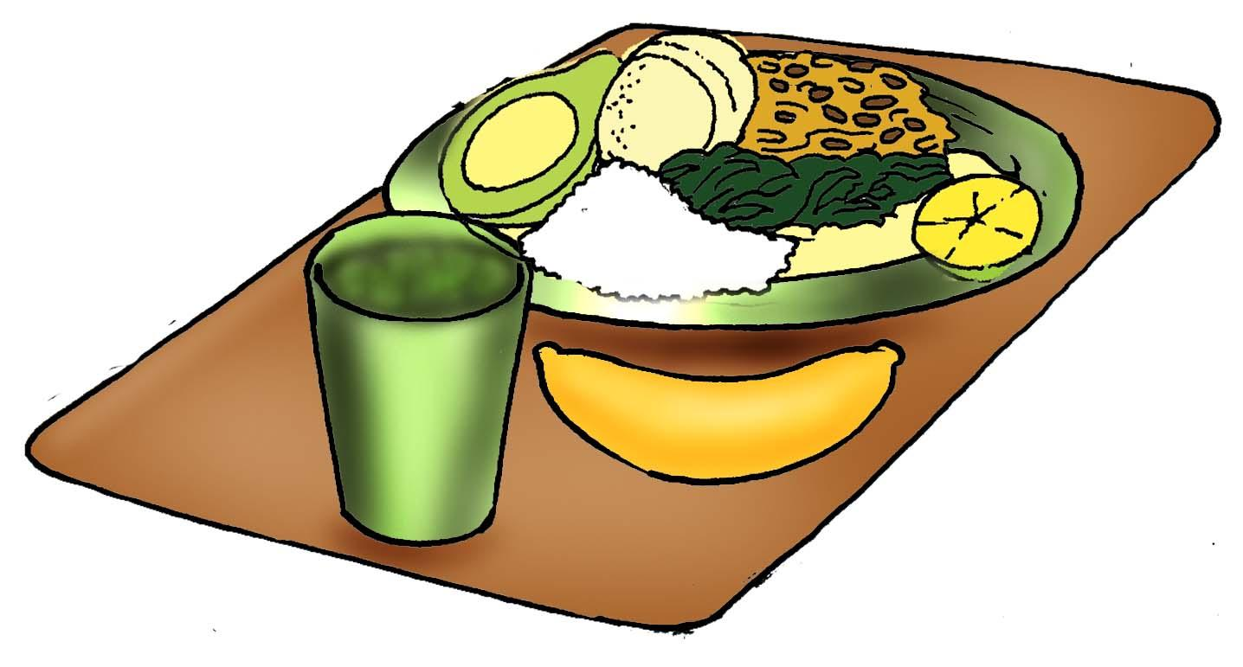
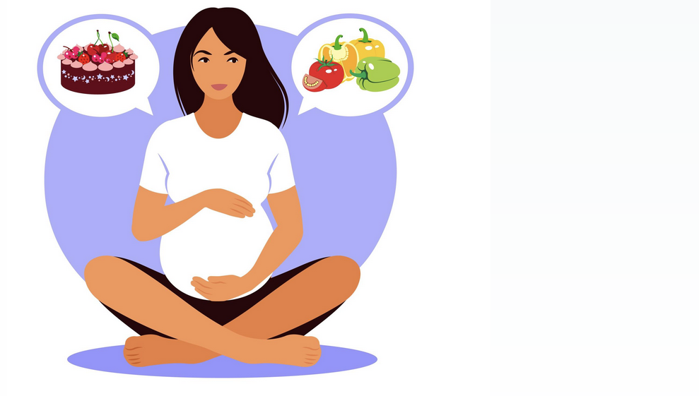
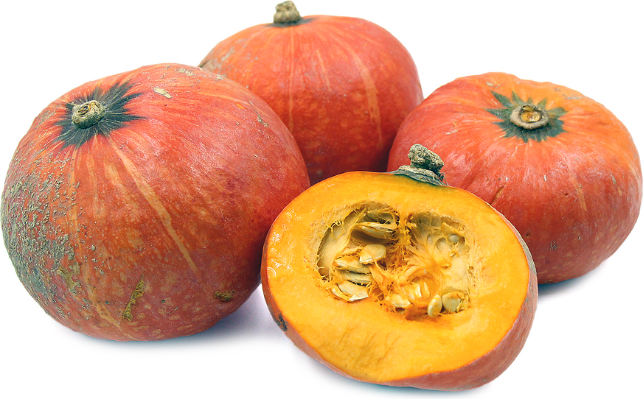
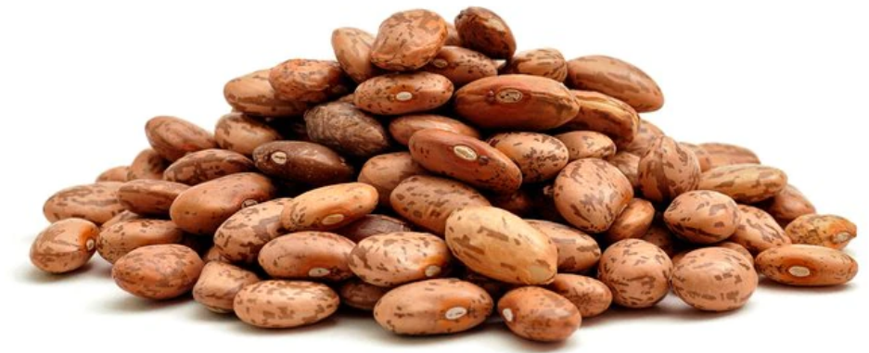


Learn about food groups
Nutrition during pregnancy
Learn about the science of nutrition

Slide 3
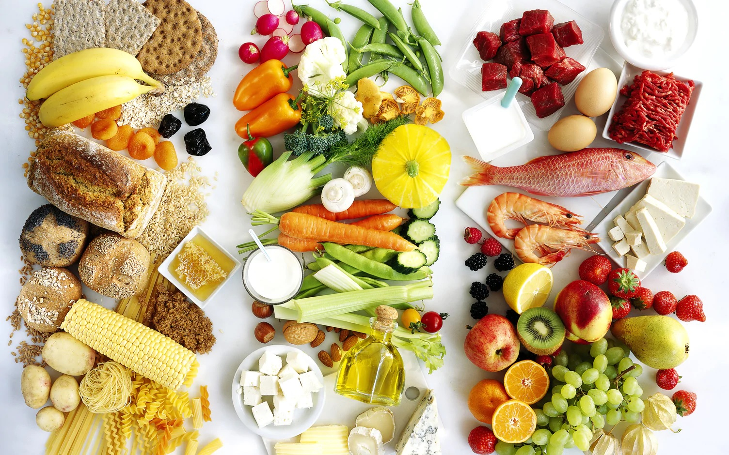
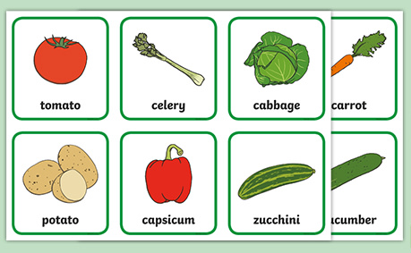
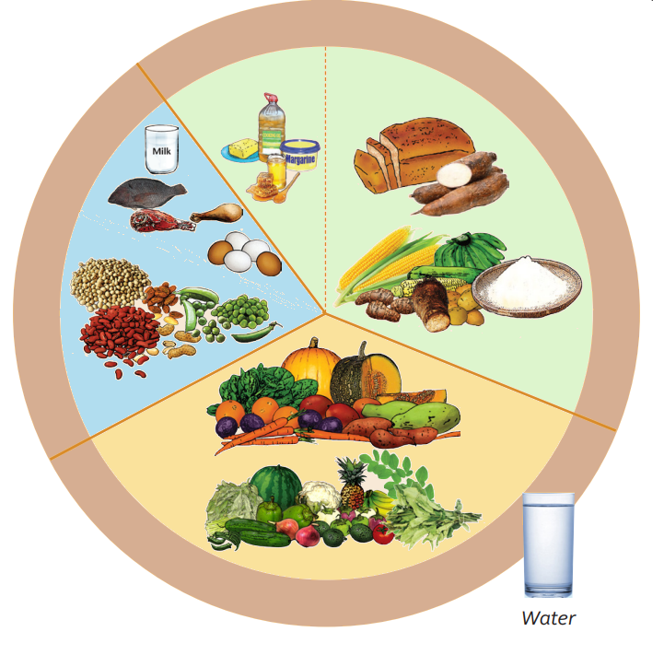
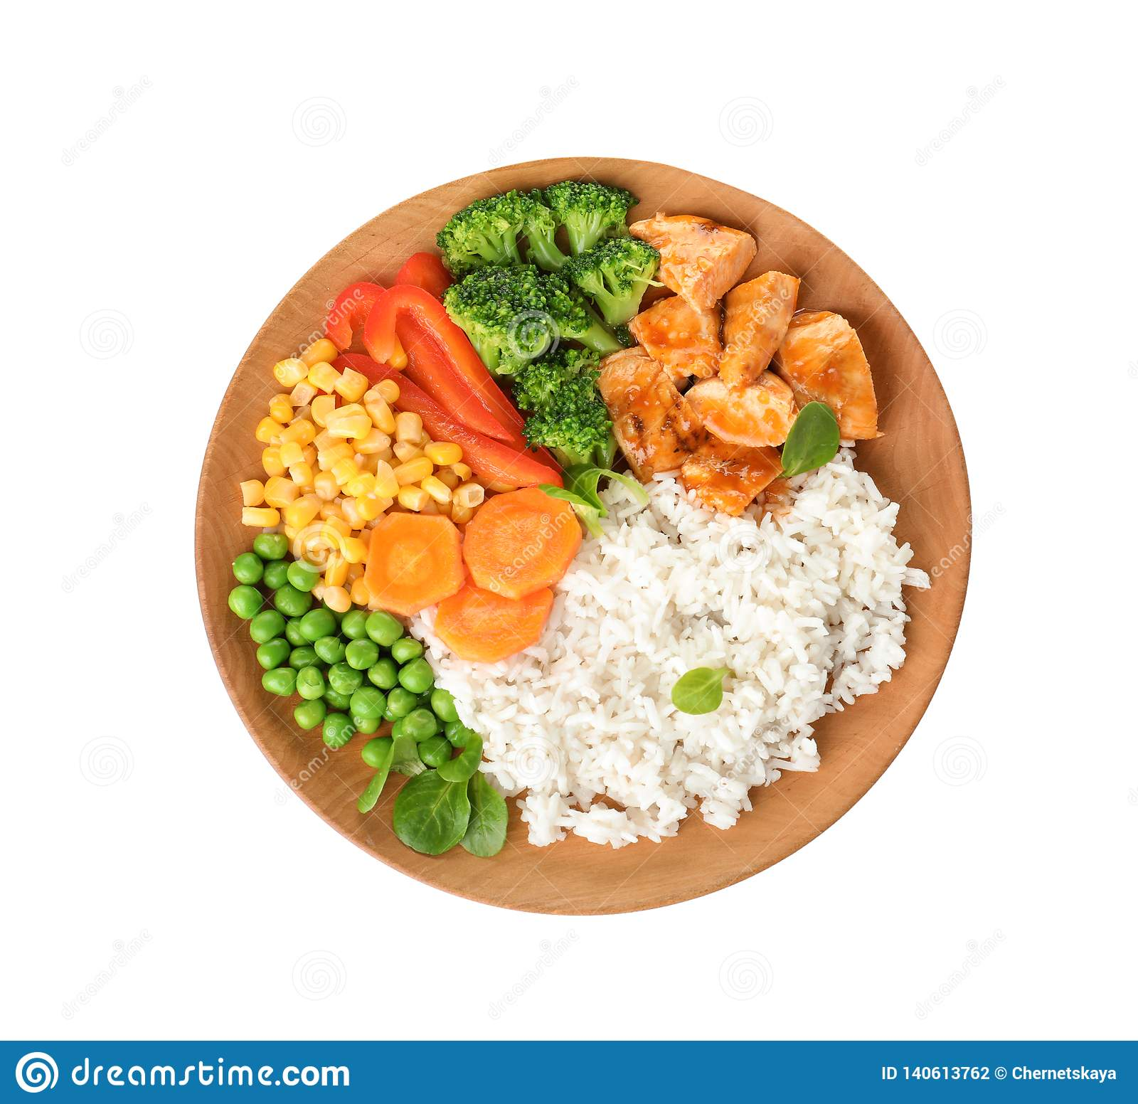
The main food groups
Practice food groups
What's on a healthy plate?
See healthy meals

Slide 4

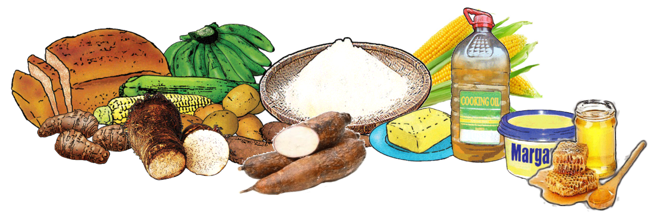

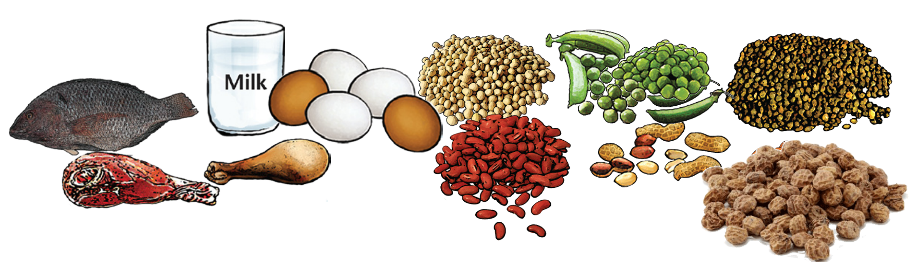

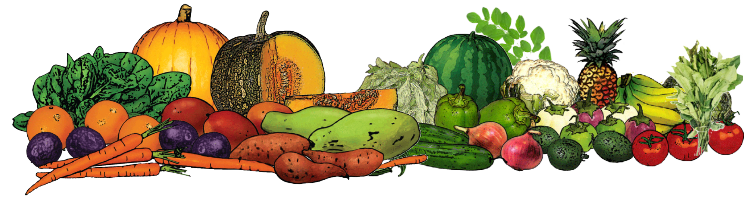


Food groups
No single food contains all the nutrients that our body needs, with the exception of breast milk for babies up to 6 months of age.
Eating well means eating a variety of foods. Food is divided into three healthy groups:
Go: Foods for energy, called carbohydrates
Grow: Foods that build muscle, called proteins
Protect: Foods that help your health, called vitamins
There is also unhealthy food, that you should eat in small amounts.

Slide 5

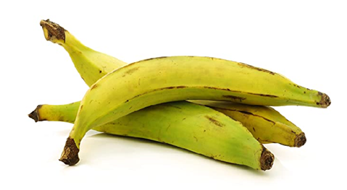
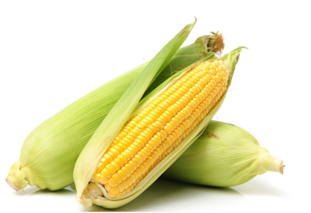
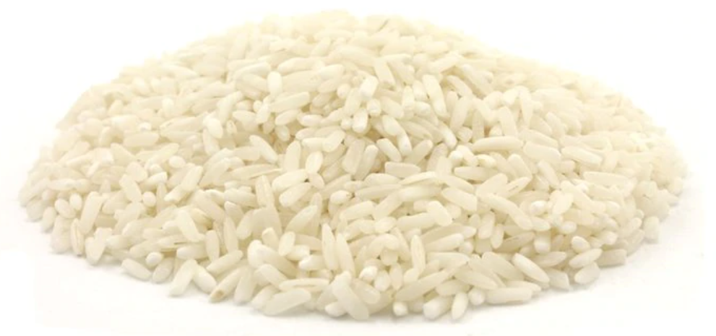
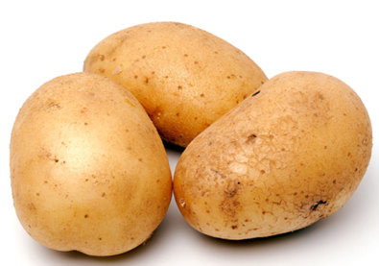
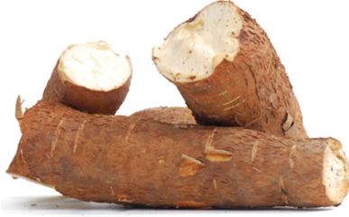
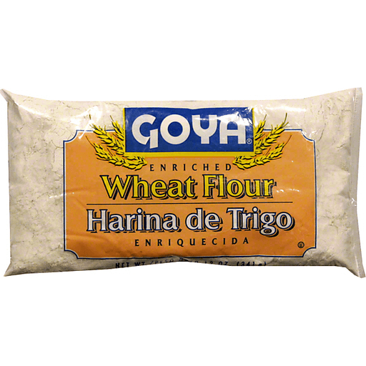
Go (carbohydrates & fats)
These foods, like firewood, give your body the energy that it needs to function throughout the day. They are called carbohydrates and fats.
Learn the science!
Corn blurb
Plantain blurb
Example foods
Rice blurb
Potato blurb
Yucca blurb
Flour blurb

Slide 6

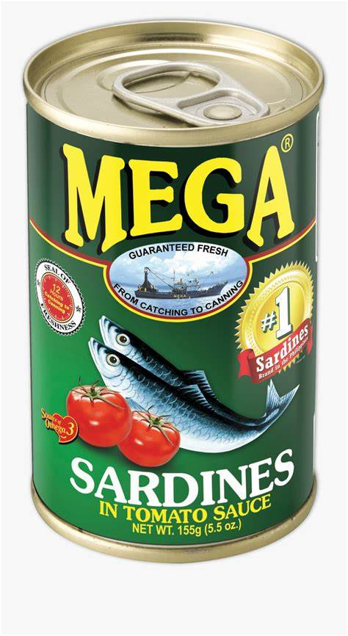
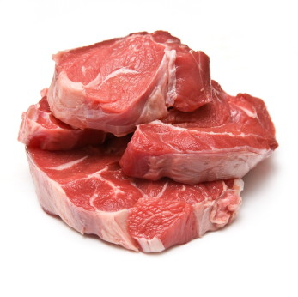

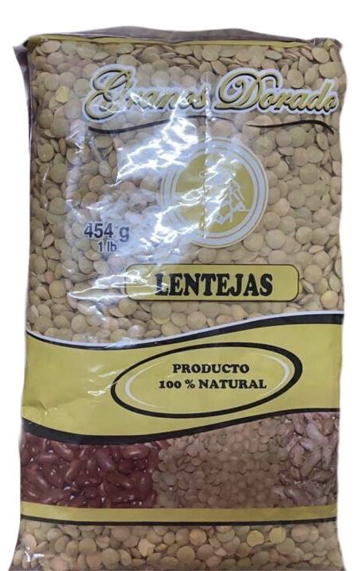
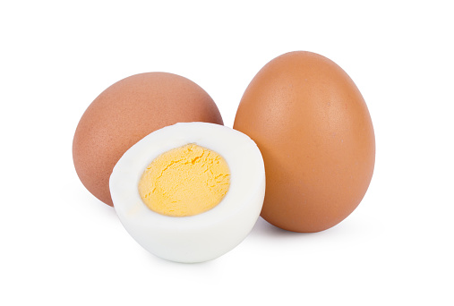
Grow: Proteins
These foods, like seeds in soil, give your body the materials it needs to grow muscles and repair itself. They are called proteins. If you don’t eat enough protein, you can feel weak and take a long time to recover from illnesses. Children will grow slowly if they don’t eat enough protein.
It is especially important for children to eat lots of “grow” foods, so that their bodies have enough materials to grow properly.
Sardines blurb
Learn the science!
Chicken blurb
Beef blurb
Example foods
Beans blurb
Egg blurb
Lentils blurb

Slide 7

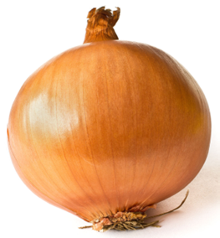
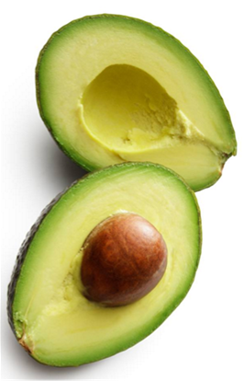
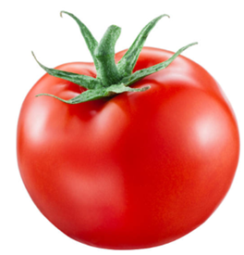
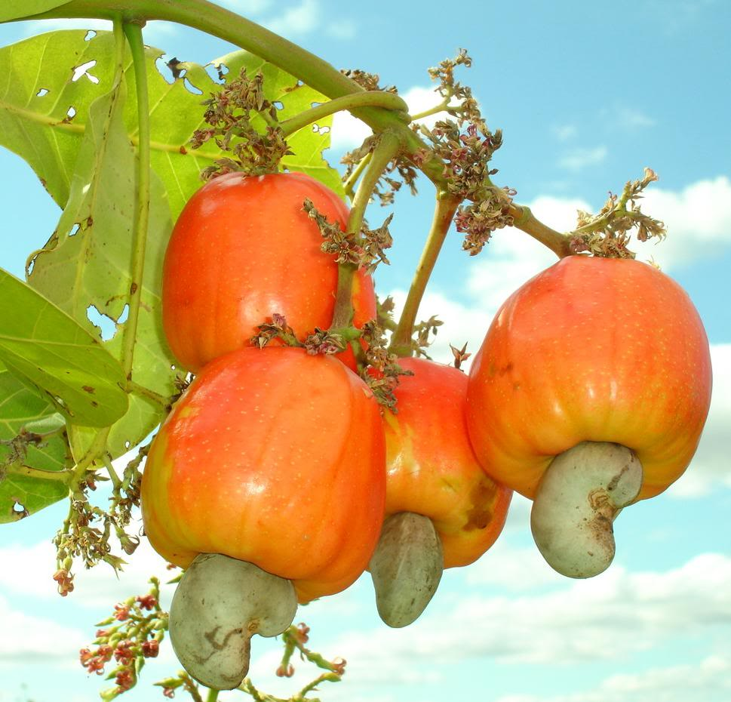
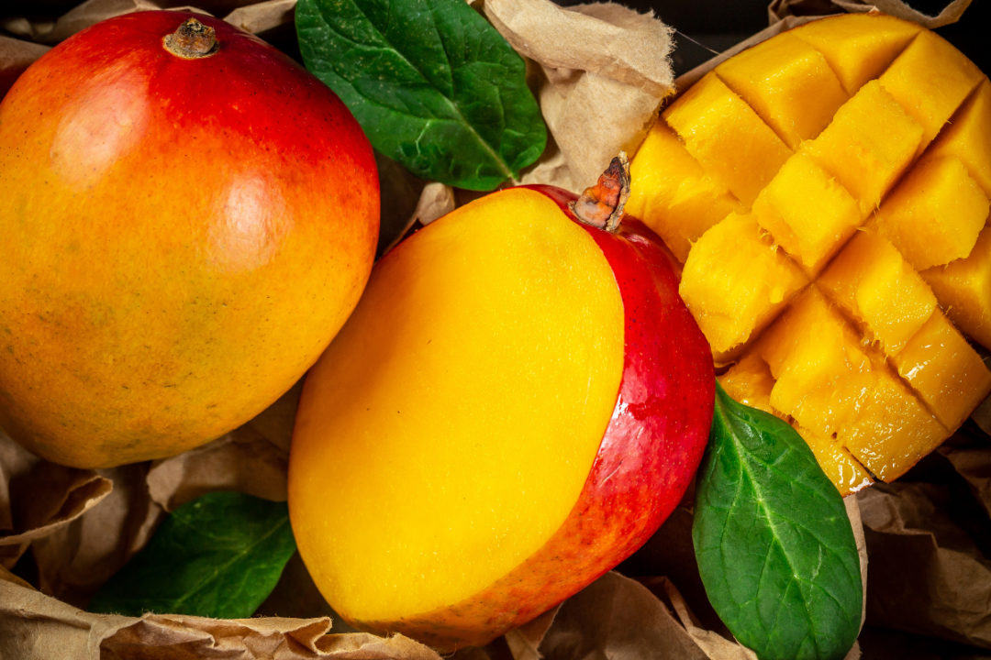

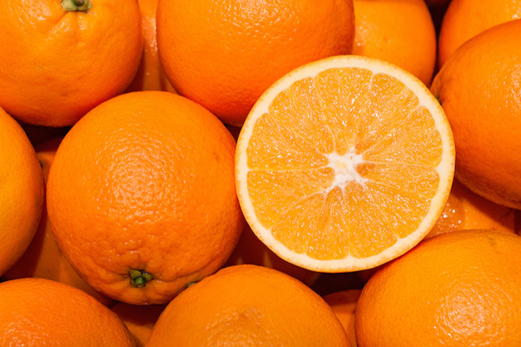




Protect: Vitamins
Our body uses these foods for many functions, from defense against illness to keeping your brain and organs running well. They are called vitamins. If you don’t eat enough vitamins, you can get sick easily and some parts of your body won’t work as well as they should. Children will be able to learn better if they eat enough vitamins.
It is especially important for children to eat lots of “protect” foods, so that their brains can grow well and their bodies can defend themselves from disease.
Onion
Avocado
Squash
Pifa
Learn the science!
Vitamins for pregnant women
Mango
Tomato
Example foods
Cashew fruit
Orange
Fern
Mushroom
Squash leaf
Yucca leaf

Slide 8

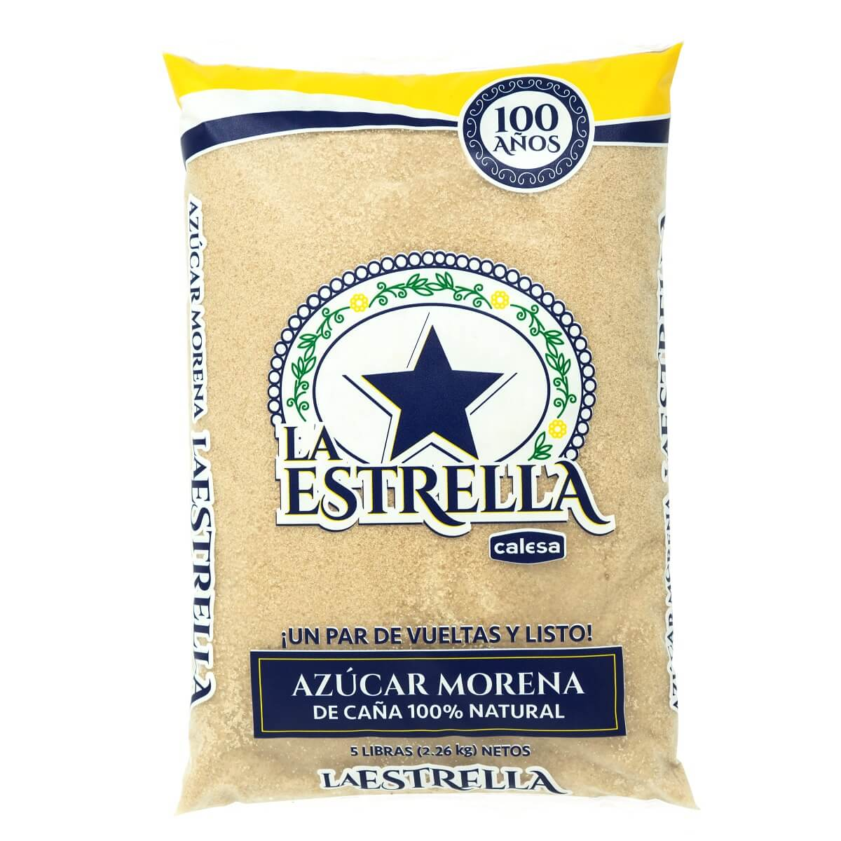




Unhealthy
These foods may taste good but they don’t help your body when you eat a lot – some of them even are harmful. Eat them only in small amounts.
Learn the science!
Oil blurb
Example foods
Sugar blurb
Cheetos blurb
Soda blurb
Candy blurb
Cookies blurb

Slide 9
A healthy plate
A healthy meal should have foods in these proportions:
For each meal, eat as much ‘grow’ and ‘protect’ food as you can.
Your body needs ‘grow’ foods to build muscle, bones and skin. You need to eat these foods every day because your body doesn’t store them.
You need ‘protect’ foods for you and your baby to grow and develop normally. Not having enough of these foods can cause health problems.
You need to drink enough water with your meals.
If you don’t drink enough water, your body can’t function properly. You can become dizzy, confused and tired. You can also have health problems that cause issues with your heart and brain over time.
For each meal, eat only enough ‘go’ food to make you feel full.
‘Go’ foods give you and your baby energy. If you don’t eat enough, your body won’t be able to work properly.
If you eat too much ‘go’ food, you can gain weight, which may cause you to be at risk for health issues including diabetes.
Learn more about the food groups

Slide 10

Put each food in its correct basket!
Go
Grow
Protect
Unhealthy
Food bank

Slide 11
Go
Grow
Go
Go
Notes:
Template for a level editor for content creator to define the categories, their names, their identifying image, and which items fit into which category.

Slide 12
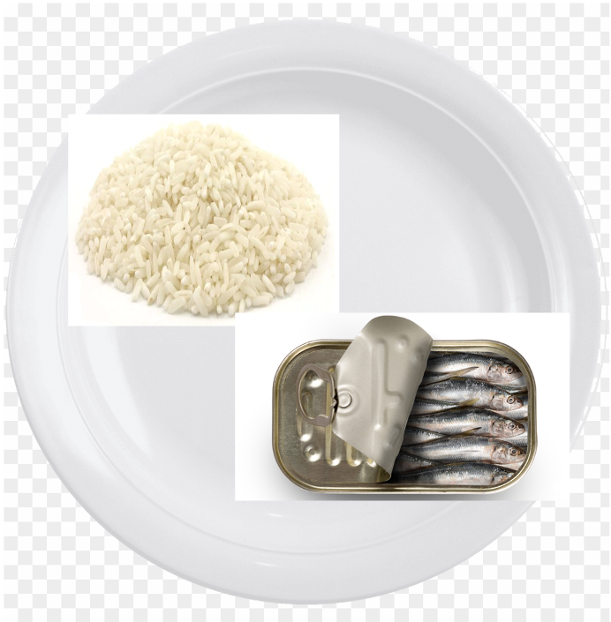
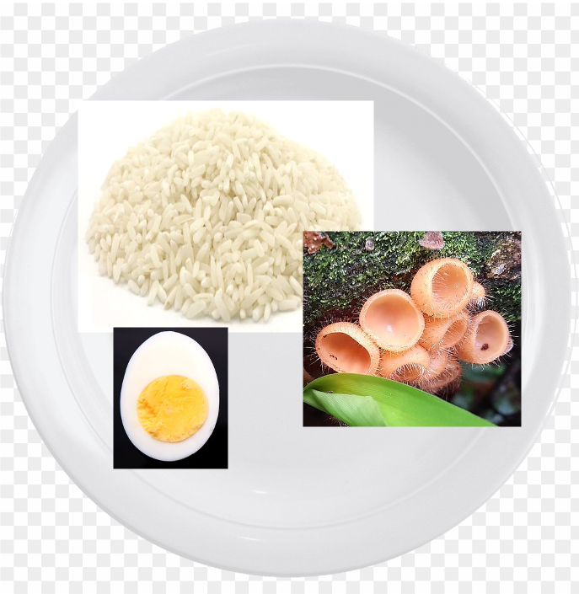

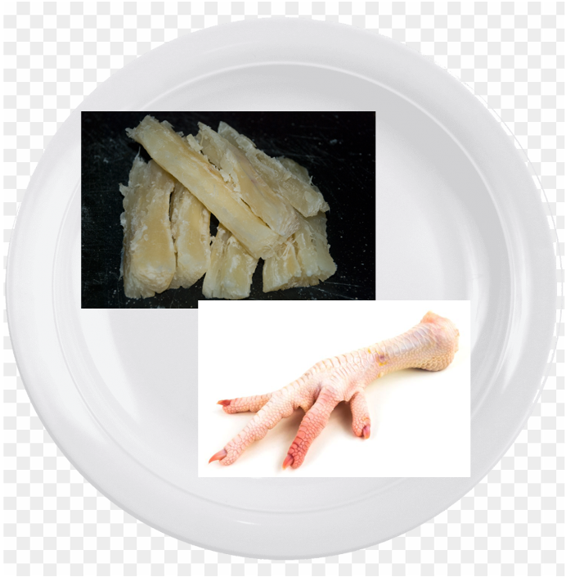
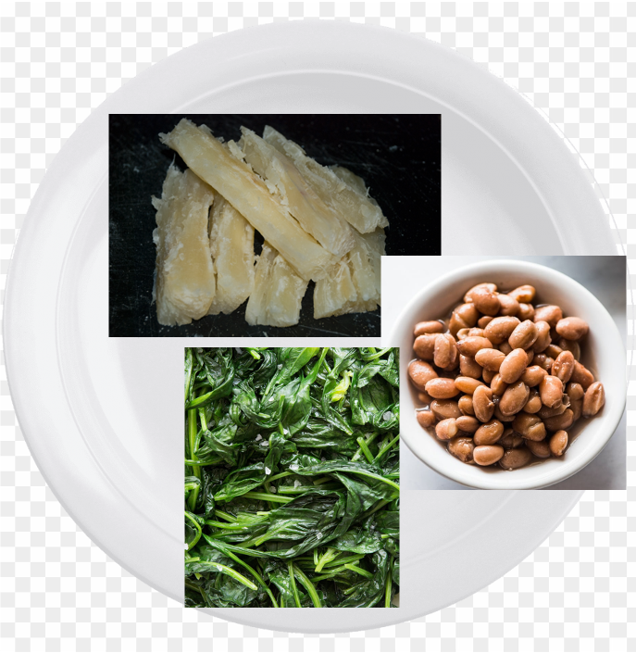
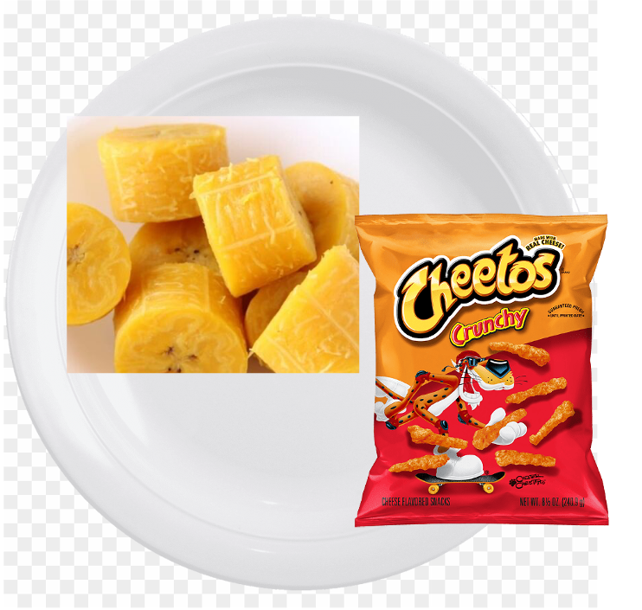
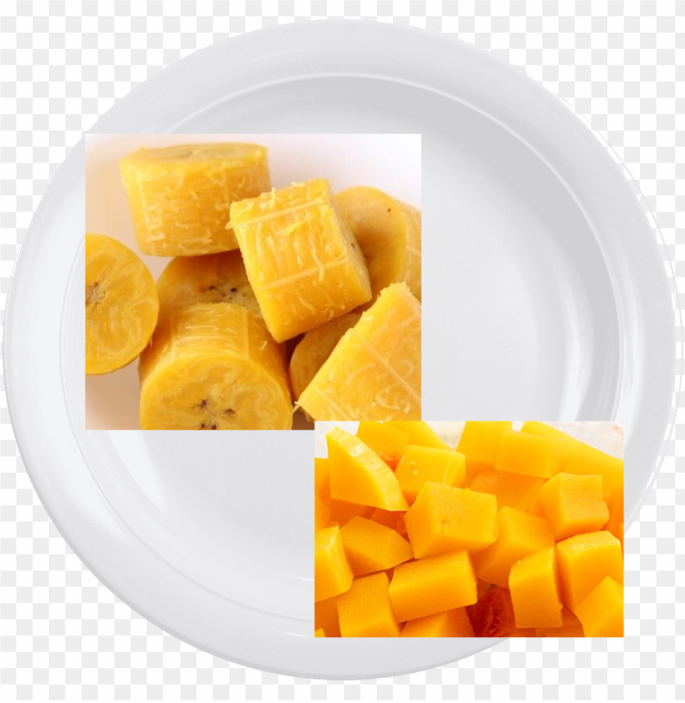
Which meals are healthiest? Which meals are least healthy? Why?

Slide 13



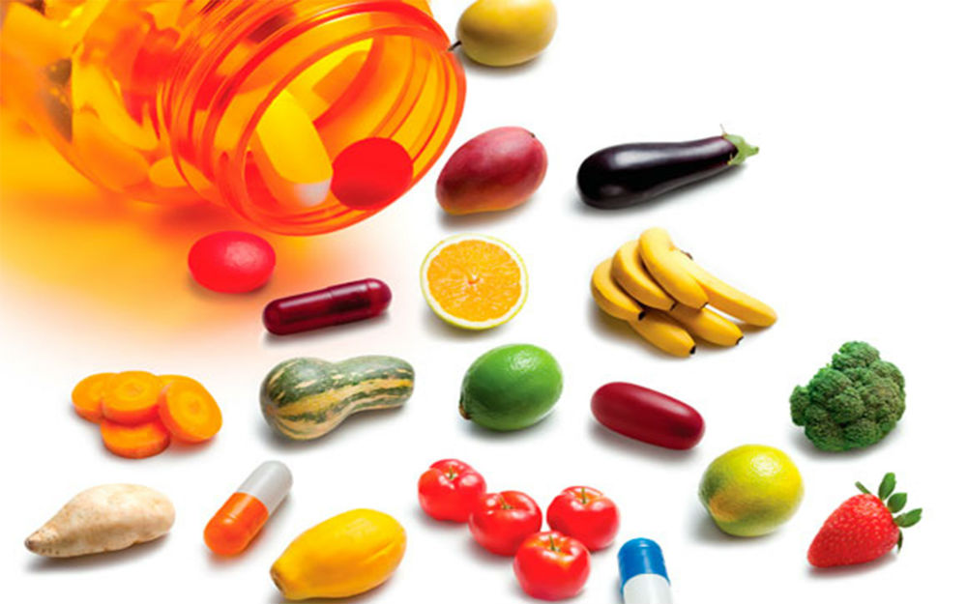

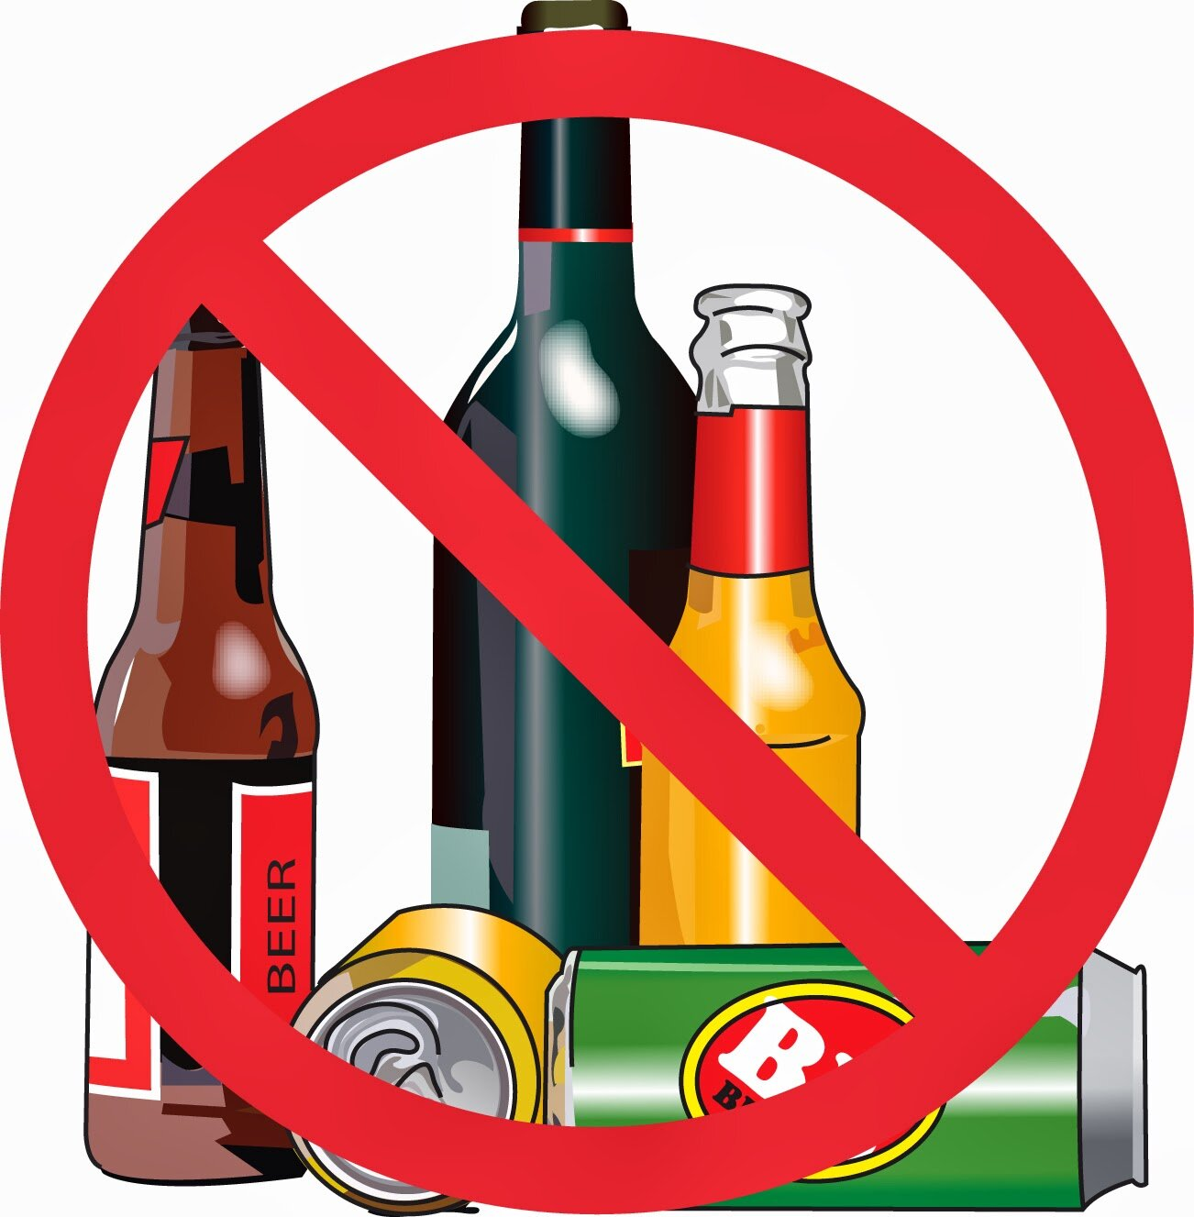
Nutrients for Pregnant Women
Eating through the day
Check-ups and Vitamins
Water
Alcohol

Slide 14
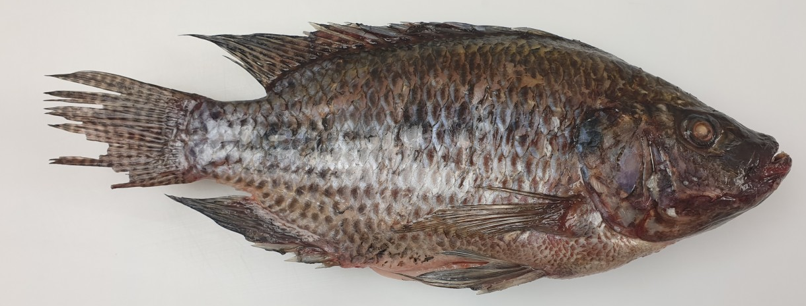
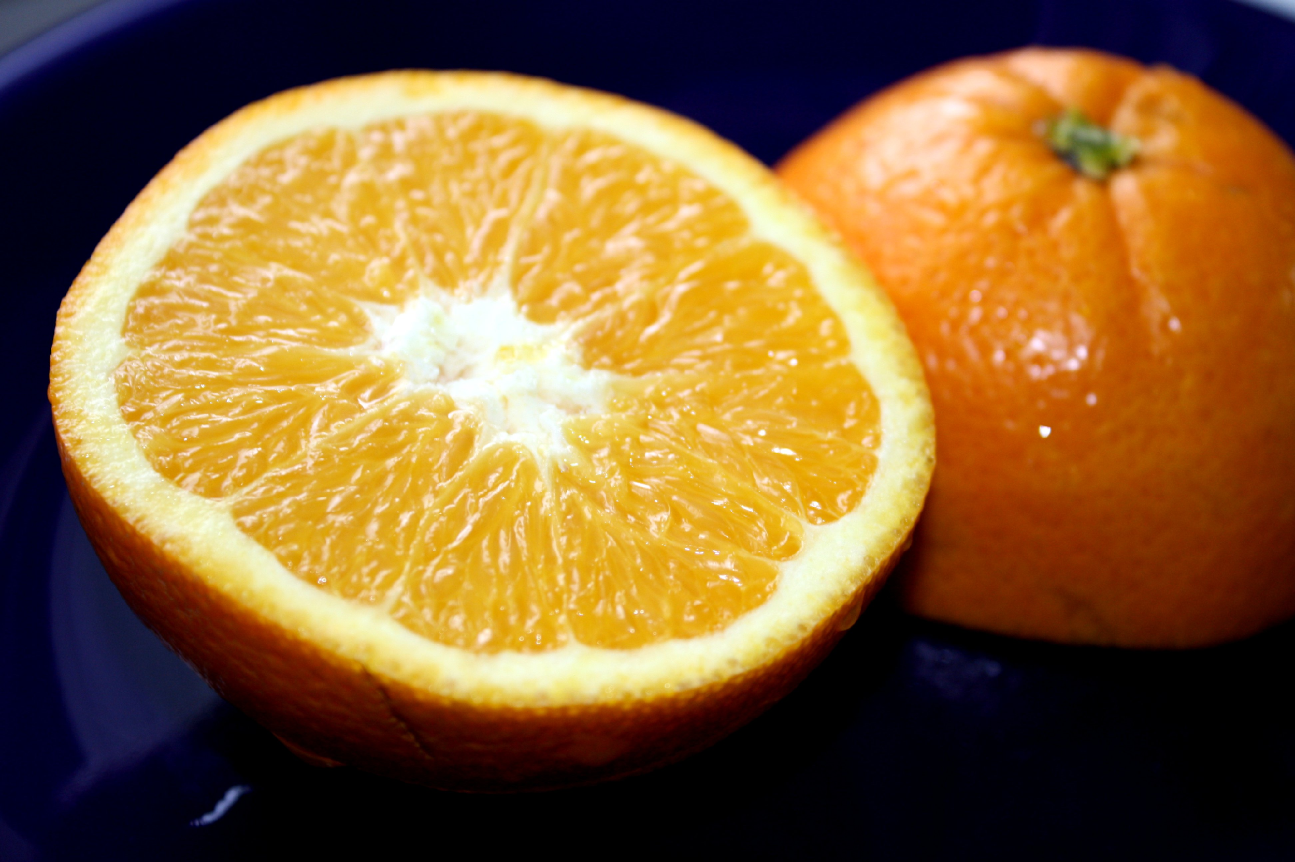
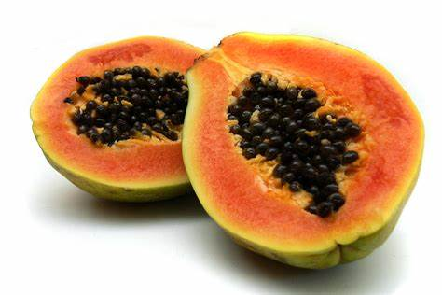
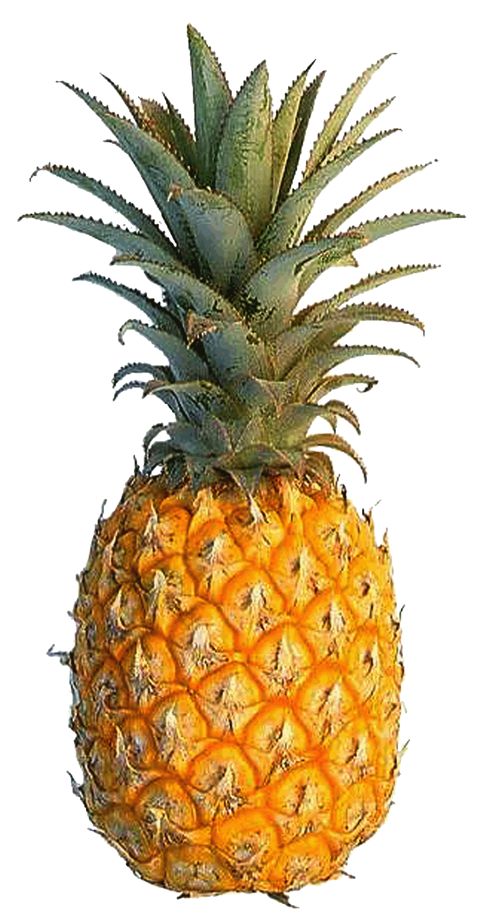

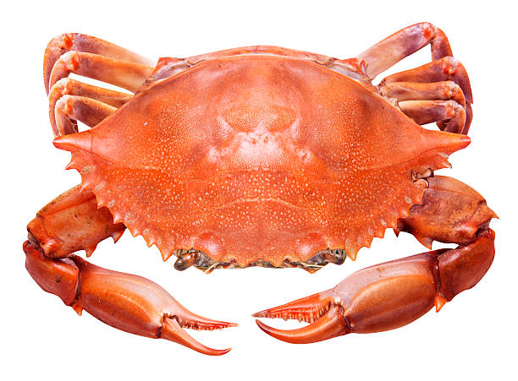


These foods help my baby's eyes develop. Without enough, I could develop poor vision at night.
Critical Nutrients for Pregnant Women
These foods strengthen my body's defense system, which fights illness and heals wounds. They help my baby's skin and bones grow.
Every day I eat a balanced diet for me and my baby. I eat foods from each​ group in the right amounts, and make sure to eat a variety of vitamins.
These foods make extra blood. My body needs extra blood to transport nutrients to my baby, which helps it grow better.
Vitamin A
Vitamin C
These foods are the building blocks of my baby's body – cells, muscles, and organs. They also help my body support the baby.
Iron
Protein
These foods help my baby's brain grow properly and prevent birth defects of the spine and brain. It's best to eat them even before I'm pregnant, since the baby's brain develops during the first month.
These foods are the building blocks of my baby's bones and teeth. If I don't eat enough, the baby will take the calcium from my bones, weakening me later in life.
Folic acid
Calcium
Calcium, Iron, and Folic Acid are important vitamins for a healthy birth. They help prevent that the baby is born early and weighs too little. Babies are more likely to survive their first month of life if their mothers ate enough of these vitamins.

Slide 15

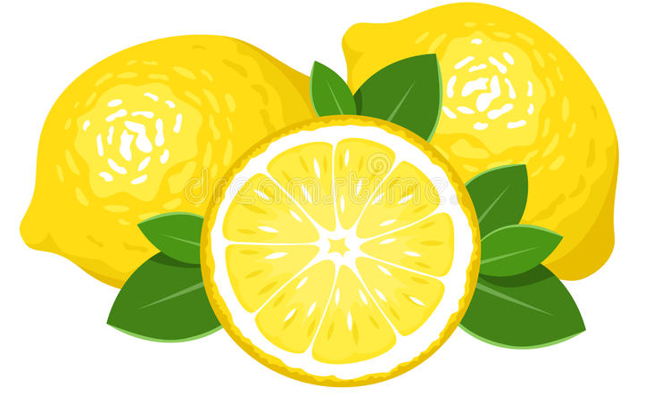



Nutrition Tips for Pregnant Women
During pregnancy, eat one extra meal or snack (extra food between meals) each day to provide energy and nutrition for you and your growing baby.
If you have cravings for a certain food, your body might need the vitamins that food contains. For example, a woman who always wants to eat limes might need more Vitamin C.
If you feel nausea, eat small meals, but more frequently (five or six times a day).
For adolescent mothers: You need extra care, more food, and more rest than an older mother. You need to nourish your own body, which is still growing, as well as your growing baby‘s.
Snacks can be a smaller amount of any nutritious food, like beans, ripe bananas, or yuca.
Non-nutritious foods like cheetos or cookies will not help you have a healthy pregnancy. They do not provide materials that support the growth of the baby. Foods that are high in salt, fat, and sugar can increase your risk of complications like hypertension and gestational diabetes

Slide 16

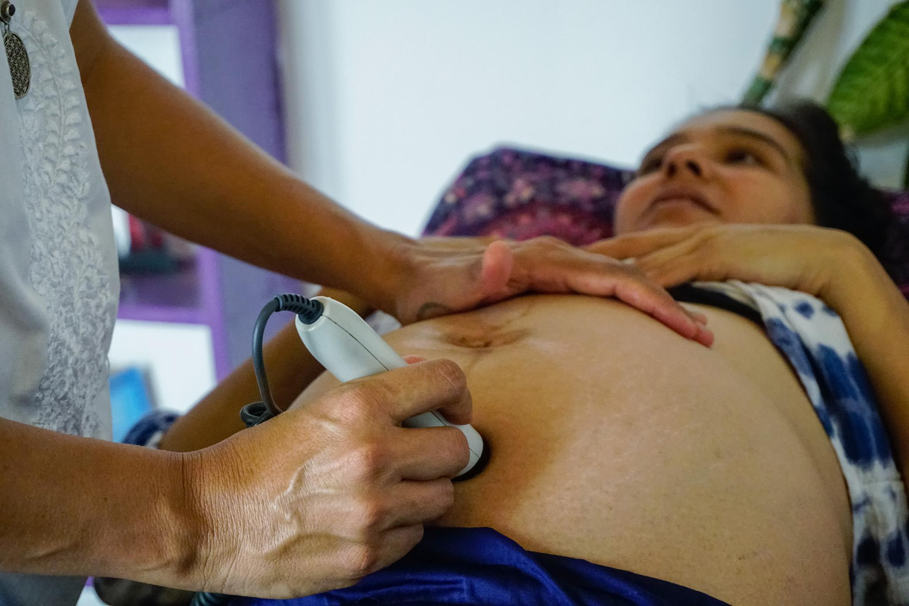

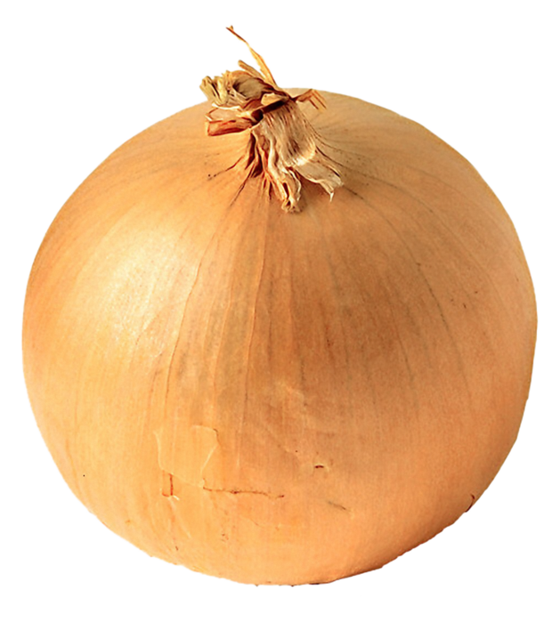
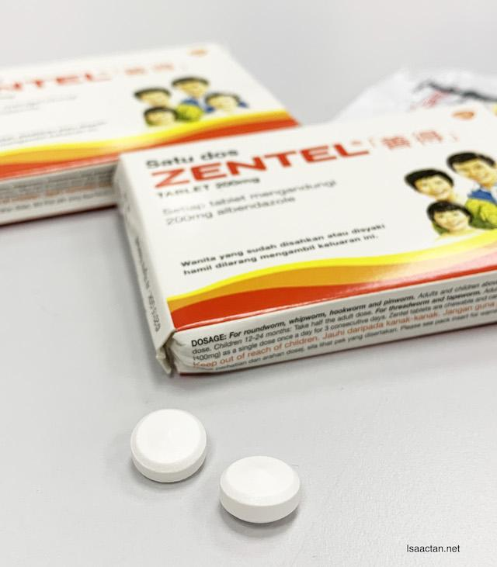
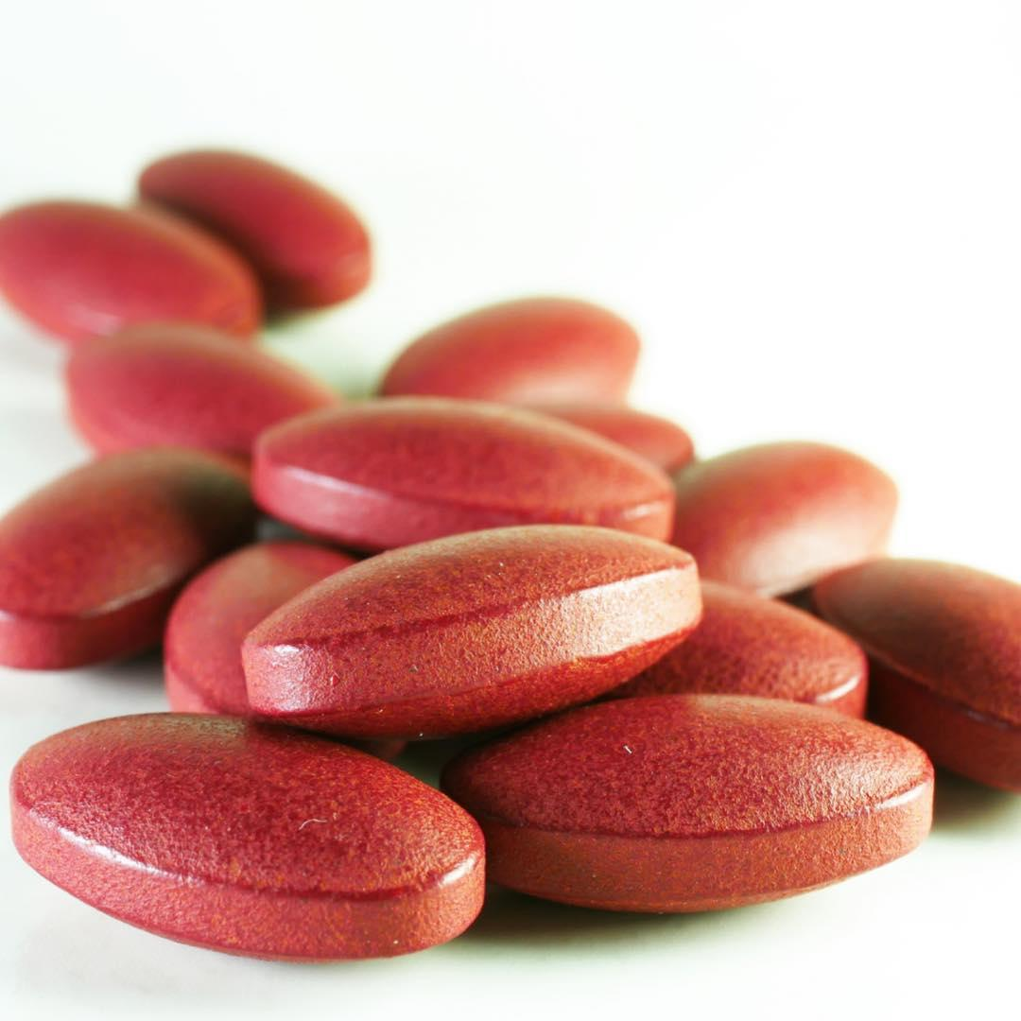
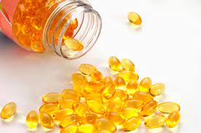


Even if you feel better, do not stop taking vitamins. Return to the clinic for a resupply.
During pregnancy, four checks at the health clinic or by your midwife are recommended. Health professionals will confirm your pregnancy and how it is progressing. Also, they will give you a tetanus shot and iron pills to protect you and your baby.
Learn your HIV status, attend all the clinic appointments, and take your medications as prescribed by the clinic. If you follow this treatment, your baby can be born healthy and without HIV. Traditional medicine cannot treat HIV.
During pregnancy, women need extra vitamins to maintain strength.
Take vitamin A tablets immediately after delivery or within 6 weeks so that your baby receives the vitamin A in your breastmilk to help prevent illness.
Take iron and folic acid tablets to prevent anemia during pregnancy and for at least 3 months after your baby‘s birth.
Take de-worming tablets to help prevent anemia.

Slide 17
Dehydration
Fluids​ ​ For hydration. ​ | The woman must not drink alcohol, including chicha fuerte. Alcohol can cause poor development throughout the child's life.​
Drink more fluids than you normally do, whenever you are thirsty.

Slide 18
Dehydration
Fluids​ ​ For hydration. ​ | The woman must not drink alcohol, including chicha fuerte. Alcohol can cause poor development throughout the child's life.​
Drink more fluids than you normally do, whenever you are thirsty.

Slide 19
The Digestive System
Building Blocks of the Body
The Immune System
Systems of the Body
How the body stores energy
How the body builds muscles
Unhealthy foods in the body
How the body uses each vitamin

Slide 20
Building Blocks of the Body

Slide 21
Systems of the Body

Slide 22
The Digestive System

Slide 23
The Immune System

Slide 24
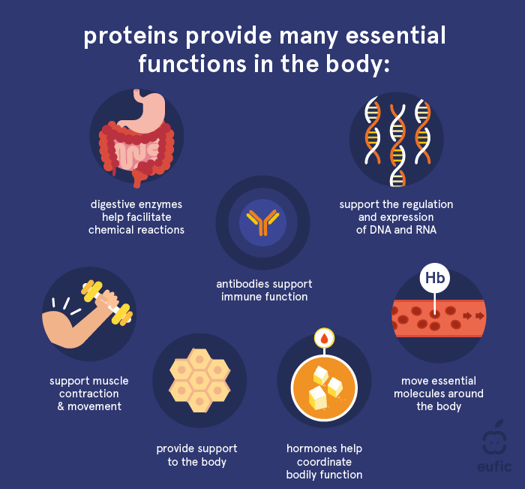
Proteins are made up of many building blocks, known as amino acids. Our body needs dietary protein to supply amino acids for the growth and maintenance of our cells and tissues.
Our dietary protein requirement changes throughout life. Adults are recommended to consume at least 0.83 g of protein per kg body weight per day (e.g. 58 g/day for a 70 kg adult).
Plant and animal-based proteins vary in their quality and digestibility, but this is not usually a concern for most people if their total protein meets their needs. We should aim to consume protein from a variety of sources.
What are proteins made of?
Proteins are made up of many different amino acids linked together. There are twenty different of these amino acid building blocks commonly found in plants and animals. A typical protein is made up of 300 or more amino acids and the specific number and sequence of amino acids are unique to each protein. Rather like the alphabet, the amino acid 'letters' can be arranged in millions of different ways to create 'words' and an entire protein 'language'. Depending on the number and sequence of amino acids, the resulting protein will fold into a specific shape. This shape is very important as it will determine the protein’s function (e.g. muscle or enzyme). Every species, including humans, has its own characteristic proteins.
Amino acids are classified as either essential or non-essential. As the name suggests, essential amino acids cannot be produced by the body and therefore must come from our diet. Whereas, non-essential amino acids can be produced by the body and therefore do not need to come from the diet.
What do proteins do for the body?
Our bodies are made up of thousands of different proteins, each with a specific function. They make up the structural components of our cells and tissues as well as many enzymes, hormones and the active proteins secreted from immune cells.
These body proteins are continually being repaired and replaced throughout our lives. This process, known as ‘protein synthesis,’ requires a continuous supply of amino acids. Although some amino acids can be recycled from the breakdown of old body proteins, this process is imperfect. This means we must eat dietary protein to keep up with our body’s amino acid demand.
As protein is essential for cell and tissue growth, adequate intake of protein is particularly important during periods of rapid growth or increased demand, such as childhood, adolescence, pregnancy, and breastfeeding.
How the body builds muscles
It is important to get enough dietary protein. You need to eat protein every day, because your body doesn't store it the way it stores fats or carbohydrates. How much you need depends on your age, sex, health, and level of physical activity.

Slide 25

Fats are a type of nutrient that you get from your diet. It is essential to eat some fats, though it is also harmful to eat too much.
The fats you eat give your body energy that it needs to work properly. During exercise, your body uses calories from carbohydrates you have eaten. But after 20 minutes, exercise depends partially on calories from fat to keep you going.
You also need fat to keep your skin and hair healthy. Fat also helps you absorb vitamins A, D, E, and K, the so-called fat-soluble vitamins. Fat also fills your fat cells and insulates your body to help keep you warm.
The fats your body gets from your food give your body essential fatty acids called linoleic and linolenic acid. They are called "essential" because your body cannot make them itself, or work without them. Your body needs them for brain development, controlling inflammation, and blood clotting.
Fat has 9 calories per gram, more than 2 times the number of calories in carbohydrates and protein, which each have 4 calories per gram.
All fats are made up of saturated and unsaturated fatty acids. Fats are called saturated or unsaturated depending on how much of each type of fatty acid they contain.
Carbohydrates are sugar molecules. Your body breaks down carbohydrates into glucose. Glucose, or blood sugar, is the main source of energy for your body's cells, tissues, and organs. Glucose can be used immediately or stored in the liver and muscles for later use.
There are three main types of carbohydrates:
Sugars can be added to foods, such as the sugar in candy, desserts, processed foods, and regular soda. They also include the kinds of sugar that are found naturally in fruits, vegetables, and milk.
Starches are made of lots of sugars strung together. Your body needs to break starches down into sugars to use them for energy. Starches include bread, cereal, and pasta. They also include certain vegetables, like potatoes, peas, and corn.
Fiber. Your body cannot break down most fibers, so eating foods with fiber can help you feel full. Diets high in fiber may help prevent stomach or intestinal problems such as constipation. They may also help lower cholesterol and blood sugar. Fiber is found in many foods that come from plants, including fruits, vegetables, nuts, seeds, beans, and whole grains.
How the body stores energy

Slide 26
Saturated fats raise your LDL (bad) cholesterol level. High LDL cholesterol puts you at risk for heart attack, stroke, and other major health problems. You should avoid or limit foods that are high in saturated fats.
Keep saturated fats to less than 6% of your total daily calories.
Foods with a lot of saturated fats are animal products, such as butter, cheese, whole milk, ice cream, cream, and fatty meats.
Some vegetable oils, such as coconut, palm, and palm kernel oil, also contain saturated fats. These fats are solid at room temperature.
A diet high in saturated fat increases cholesterol buildup in your arteries (blood vessels). Cholesterol is a soft, waxy substance that can cause clogged, or blocked, arteries.
Eating unsaturated fats instead of saturated fats can help lower your LDL cholesterol. Most vegetable oils that are liquid at room temperature have unsaturated fats. There are two kinds of unsaturated fats:
Mono-unsaturated fats, which include olive and canola oil
Polyunsaturated fats, which include safflower, sunflower, corn, and soy oil
Trans fatty acids are unhealthy fats that form when vegetable oil goes through a process called hydrogenation. This leads the fat to harden and become solid at room temperature. Hydrogenated fats, or "trans fats," are often used to keep some foods fresh for a long time.
Trans fats are also used for cooking in some restaurants. They can raise LDL cholesterol levels in your blood. They can also lower your HDL (good) cholesterol levels.
Trans fats are known to have harmful health effects. Experts are working to limit the amount of trans fats used in packaged foods and restaurants.
You should avoid foods made with hydrogenated and partially hydrogenated oils (such as hard butter and margarine). They contain high levels of trans-fatty acids.
It is important to read nutrition labels on foods. This will help you know what kinds of fats, and how much, your food contains.
Try to avoid foods that have a lot of added sugar. These foods can have many calories but not much nutrition. Eating too much added sugar raises your blood sugar and can make you gain weight. You can tell if a food or drink has added sugars by looking at the Nutrition Facts label on the back of the food package. It tells you how much total sugar and added sugar is in that food or drink.
Your kidneys control how much sodium is in your body. If you have too much and your kidneys can't get rid of it, sodium builds up in your blood. This can lead to high blood pressure. High blood pressure can lead to other health problems.
Not all fats are the same. You should try to avoid:
Saturated fats such as butter, solid shortening, and lard
Trans fats. These are found in vegetable shortenings, some margarines, crackers, cookies, snack foods, and other foods made with or fried in partially hydrogenated oils.
Fat has twice as many calories as proteins or carbohydrates.
Unhealthy foods in the body

Slide 27
Vitamins are substances that your body needs to grow and develop normally.
There are 13 vitamins your body needs. Each vitamin has specific jobs. If you have low levels of certain vitamins, you may get health problems. Some vitamins may help prevent medical problems.
Minerals are important for your body to stay healthy. Your body uses minerals for many different jobs, including keeping your bones, muscles, heart, and brain working properly. Minerals are also important for making hormones.
The best way to get enough vitamins and minerals is to eat a balanced diet with a variety of foods.
How the body uses each vitamin

Slide 28
Settings

Slide 29
Could add later on:
- Pre and post counselling quiz (to reinforce learning)
- Self-assessment (for diabetes risk factors or food/water hygiene, e.g.) (could direct them to a specific water treatment page depending on their results)
- Recipes
- Critical handwashing times
During breastfeeding, eat two extra small meals or snacks (extra food between meals) each day to provide energy and nutrition for you and your growing baby.

